Slide 1
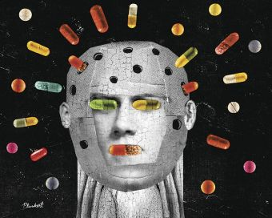
REMINDER….
Psychologist: Individuals who have earned a doctoral degree and are interested in the behavior of humans and animals
VS
Psychiatrist: Physician with specialized training in the medical treatment of mental and emotional disorders – diagnosis and treatment of mental illnesses (medical doctors)

Slide 2
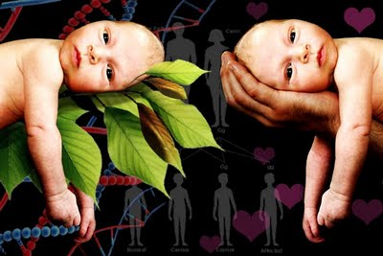
NATURE VS. NURTURE
DECK - PSYCH

Slide 3
NATURE VS. NURTURE
This debate within psychology is concerned with the extent to which particular aspects of behavior are a product of either inherited (i.e. genetic) or acquired (i.e. learned) characteristics.
NATURE – refers to that which is inherited/genetic.
NUTURE – all environmental influences after conception, i.e. experience.

Slide 4
Nature vs. nurture continued…
The nature vs nurture argument is an age-old discussion that has occupied many scholars in the field of child development and beyond.
What type/s of psychologist/s might study this?
Are we born with our intelligence, ability to learn, and personality traits pre-destined? Or does our environment, the method in which we are raised and educated, have the ability to make drastic changes?
Tabula Rasa – are we born a blank slate and gradually filled as we have different experiences? (Behaviorism)

Slide 5
You are probably wondering who Maslow is…and what the physical needs are all about…

Slide 6
Maslow’s hierarchy of needs:
All human beings share the basic need to grow to their fullest potential – SELF ACTUALIZATION

Slide 7
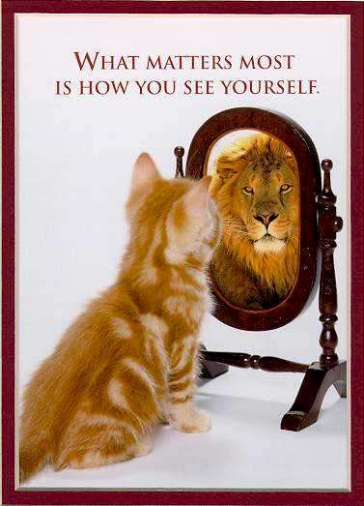
Theory Overview
Maslow's theory suggests that the most basic level of needs must be met before the individual will strongly desire (or focus motivation upon) the higher level needs.
Metamotivation -the motivation of people who go beyond the scope of the basic needs and strive for constant betterment.
Metamotivated people are driven by B-needs (Being Needs), instead of deficiency needs (D-Needs – esteem, friendship, love, security).

Slide 8
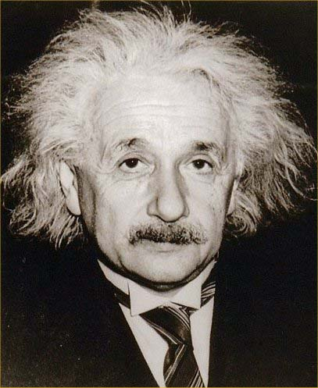
Maslow’s Research
Maslow studied what he called exemplary people such as Einstein, rather than mentally ill people.
Also studied the healthiest 1% of the college student population at the time.
Looked for what they did that made them successful and what drove them or motivated them – summarized in his hierarchy of needs.

Slide 9
Self-Actualization
“What a man can be, he must be.”
What a person's full potential is and realizing that potential.
The desire to become everything that one is capable of becoming.
When applied to individuals the need is specific such as a desire to become an ideal parent, good athlete, or best artist one can be.
In order to reach a clear understanding of this level, one must first not only achieve previous needs, but master these needs.

Slide 10
Documentary – Dr. money and THE BOY WITH NO PENIS
Boy with no penis
This is a documentary about one of twin boys whose penis got burned off during circumcision. The boy would be scarred for life and would have to live with terrible psychological consequences… unless he became a she. Is it possible to change the gender of a human being completely? What factors determine the gender of a person? Dr. Money And The Boy With No Penis is a documentary investigating these questions. It presents the scientific theories of Dr. Money stating that nurture (instead of nature) eventually determines gender.

Slide 11
Extended response assignment
In a well written paragraph state and discuss your side of the argument using 3 specific pieces of evidence.
Evidence might be:
Personal experience
Reference from the article.
Reference from the movie.

